Slide 1

Media
Entertainment
Needfinding Report

Slide 2
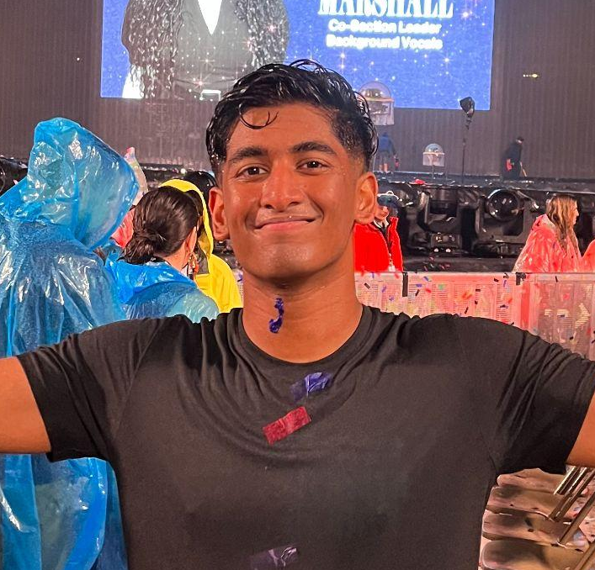
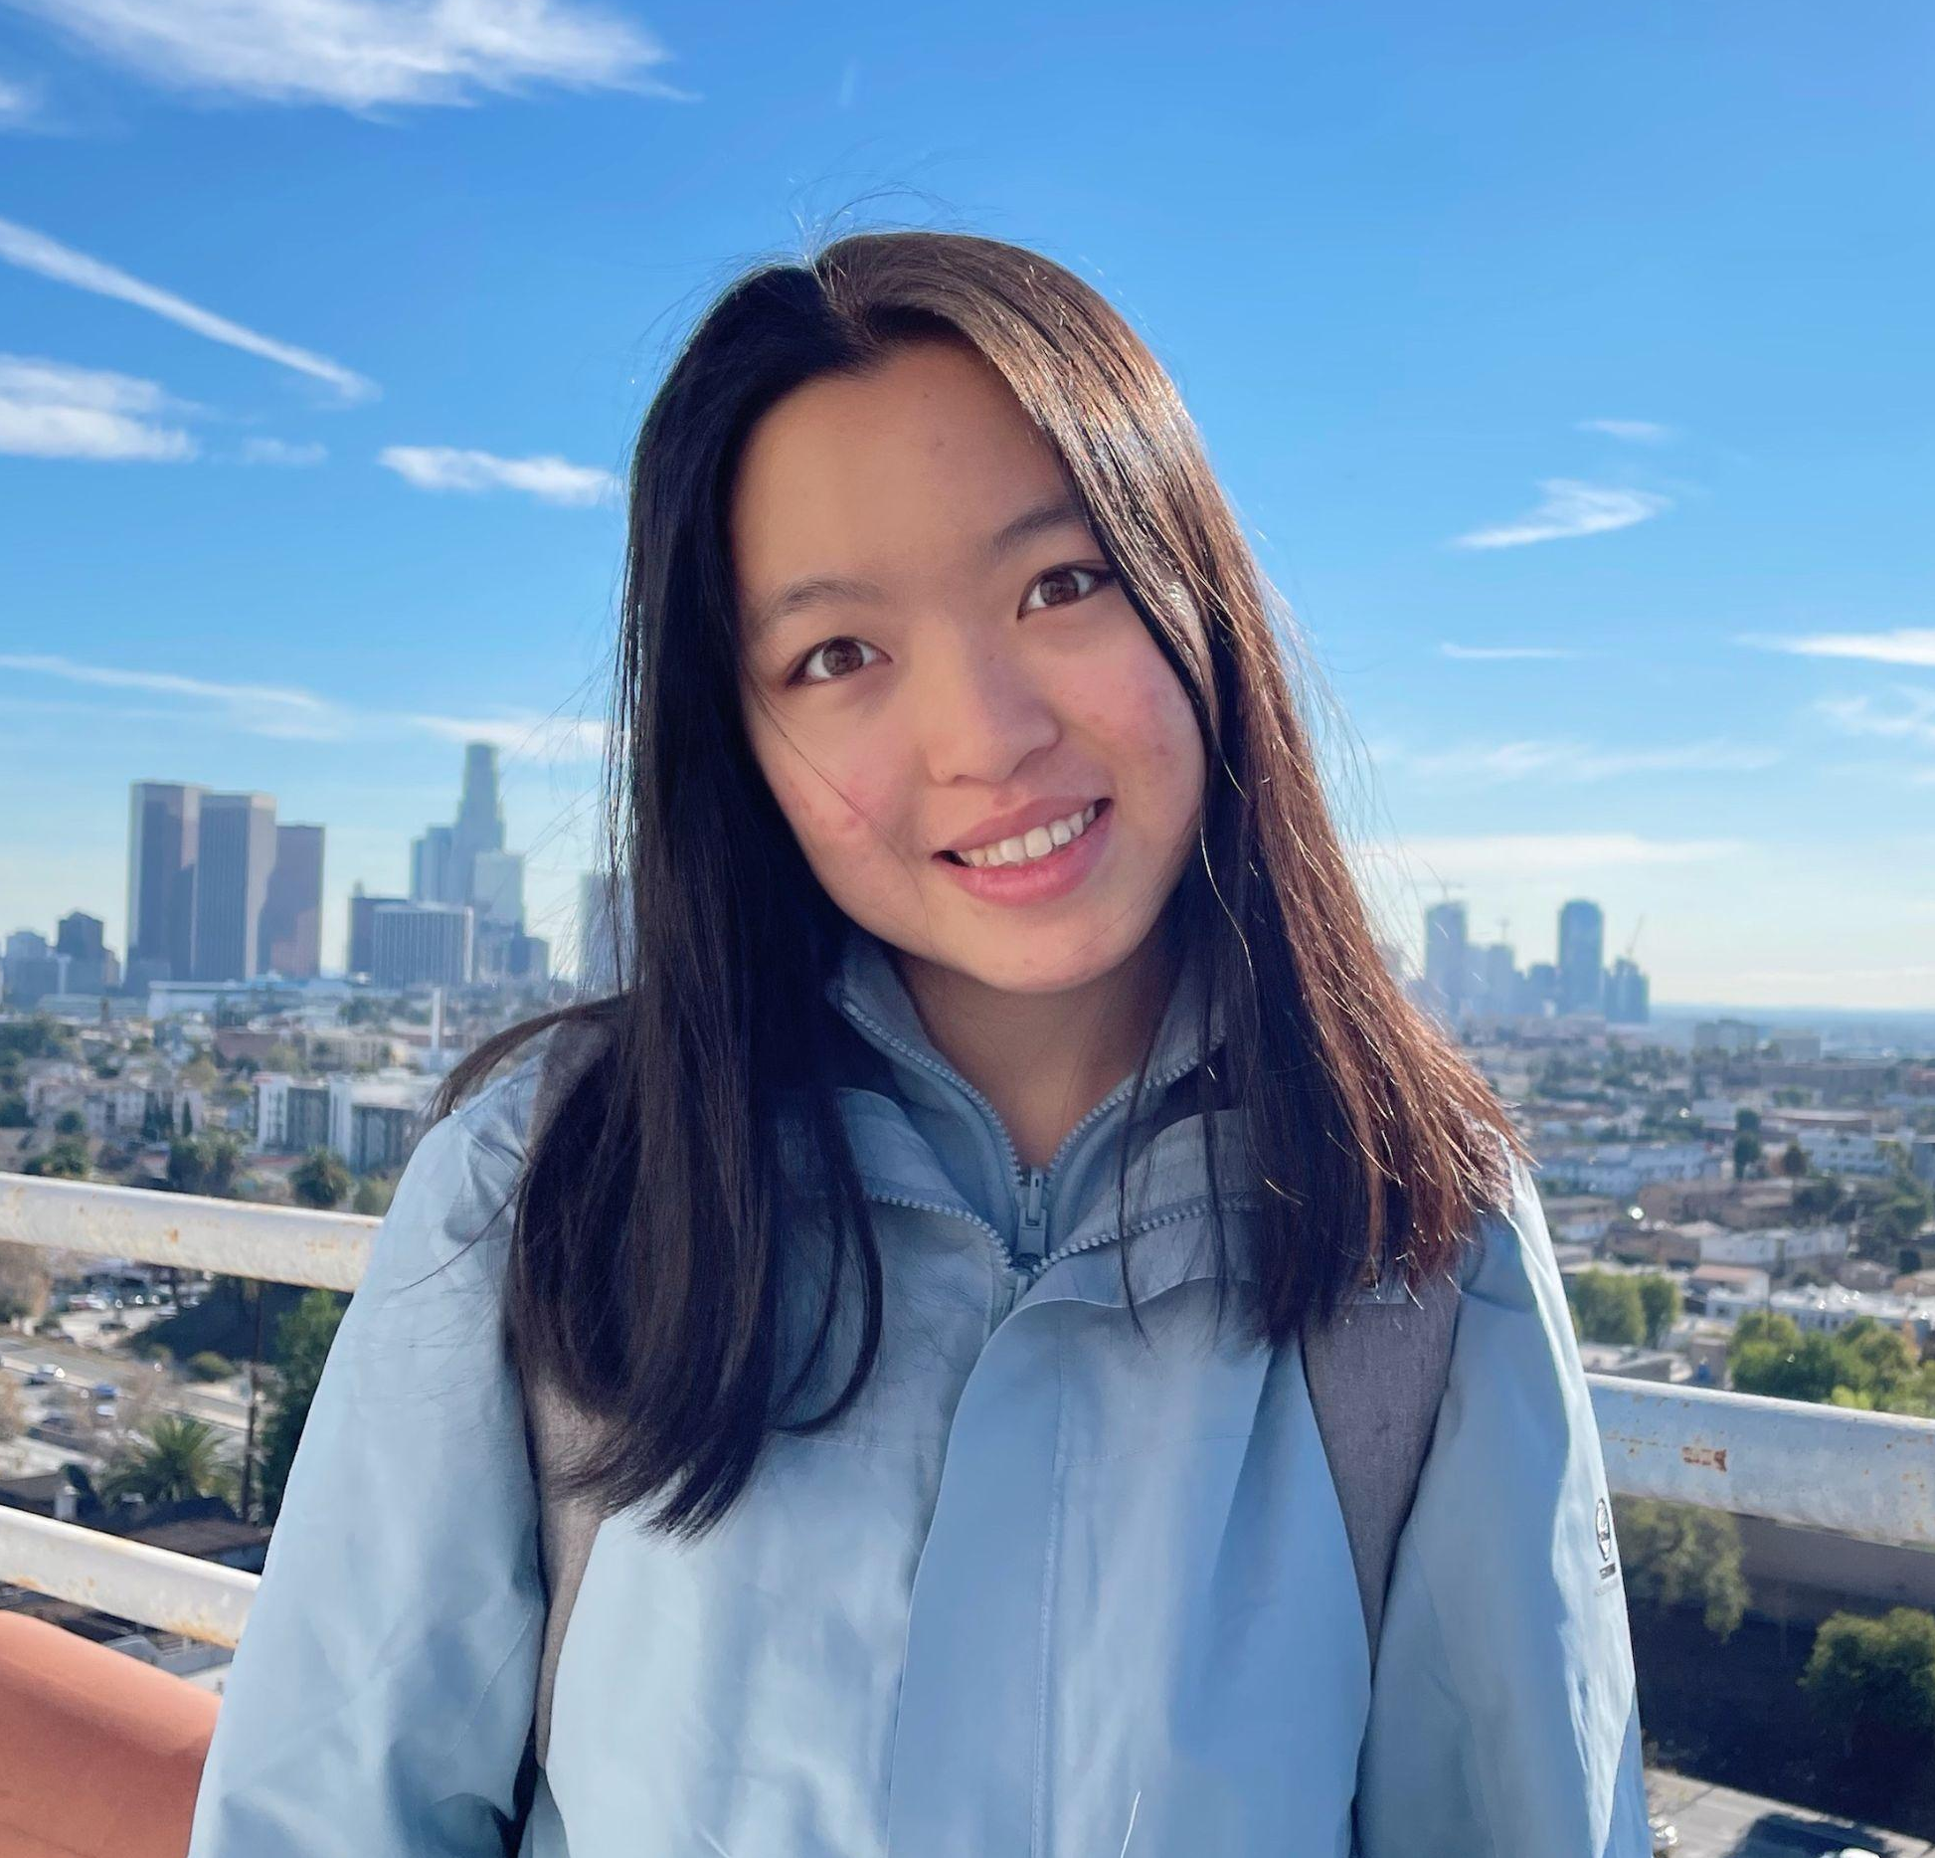
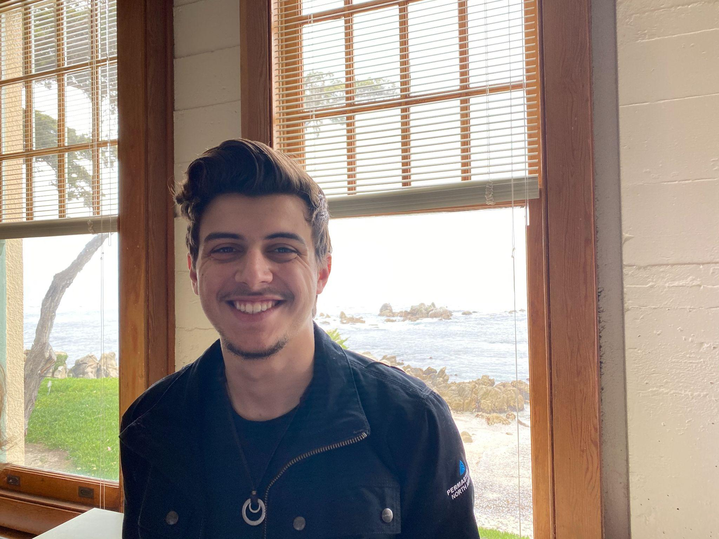
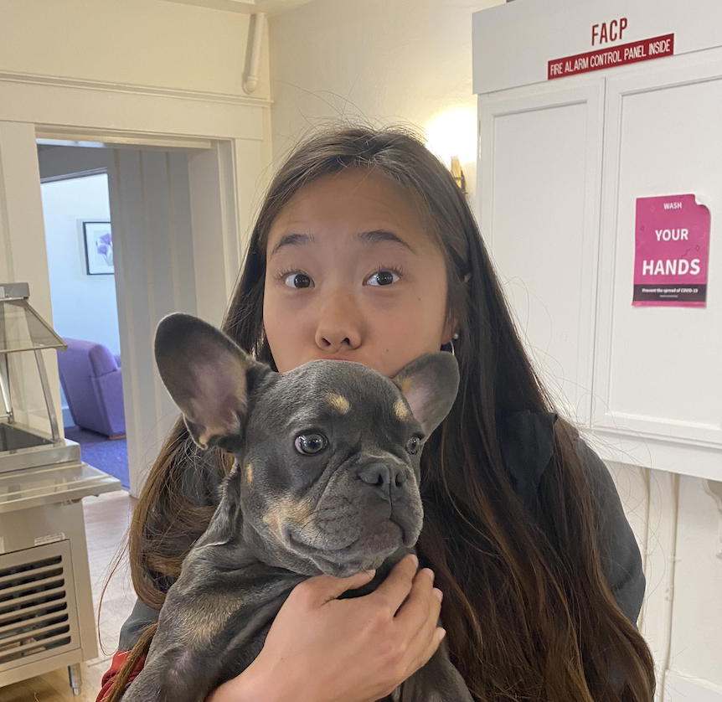
Meet Our Team
Allen Naliath
Charlotte Zhu
Francis Santiago
Yishu Chen
‘25
Boston, MA
‘25
Suzhou, China
‘23/’24
Miami, FL
‘23/’24
Hong Kong

Slide 3
Domain Selection
01
02
Brainstorming
Indecision
Reflecting on personal needs and experiences
Stuck between two different domains.
In-depth exploration
03
04
Research
Media/Entertainment
Exploration of existing products
Information from interviews
Identified a gap in existing products and in people’s needs
Notes:
Reflecting on personal needs and experiences. What domains do we know of that could use innovation?
Stuck between two very different domains. In-depth exploration of both ensued.
Exploration of existing products in entertainment. Using information from interviews to see what needs were most salient.
Identified a gap in existing products and in the needs of the individuals we interviewed. Chose a domain that has the greatest potential for exploration.

Slide 4
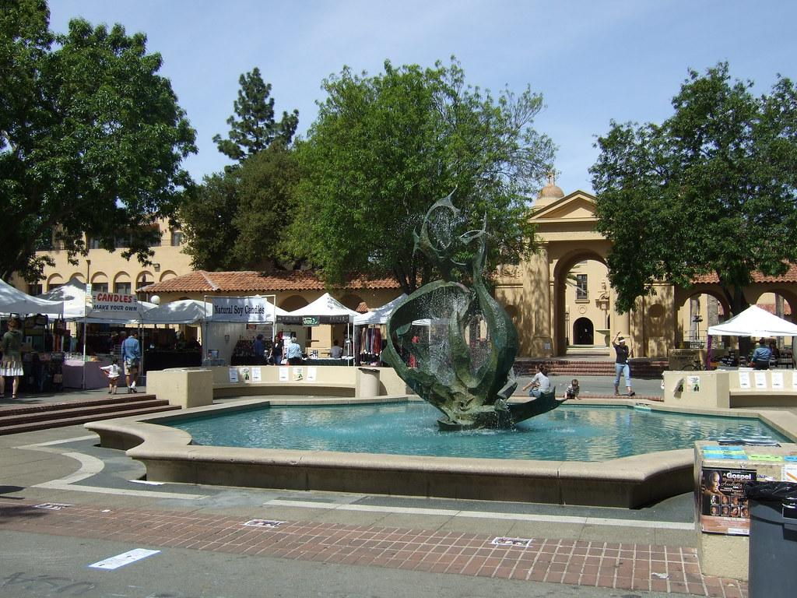
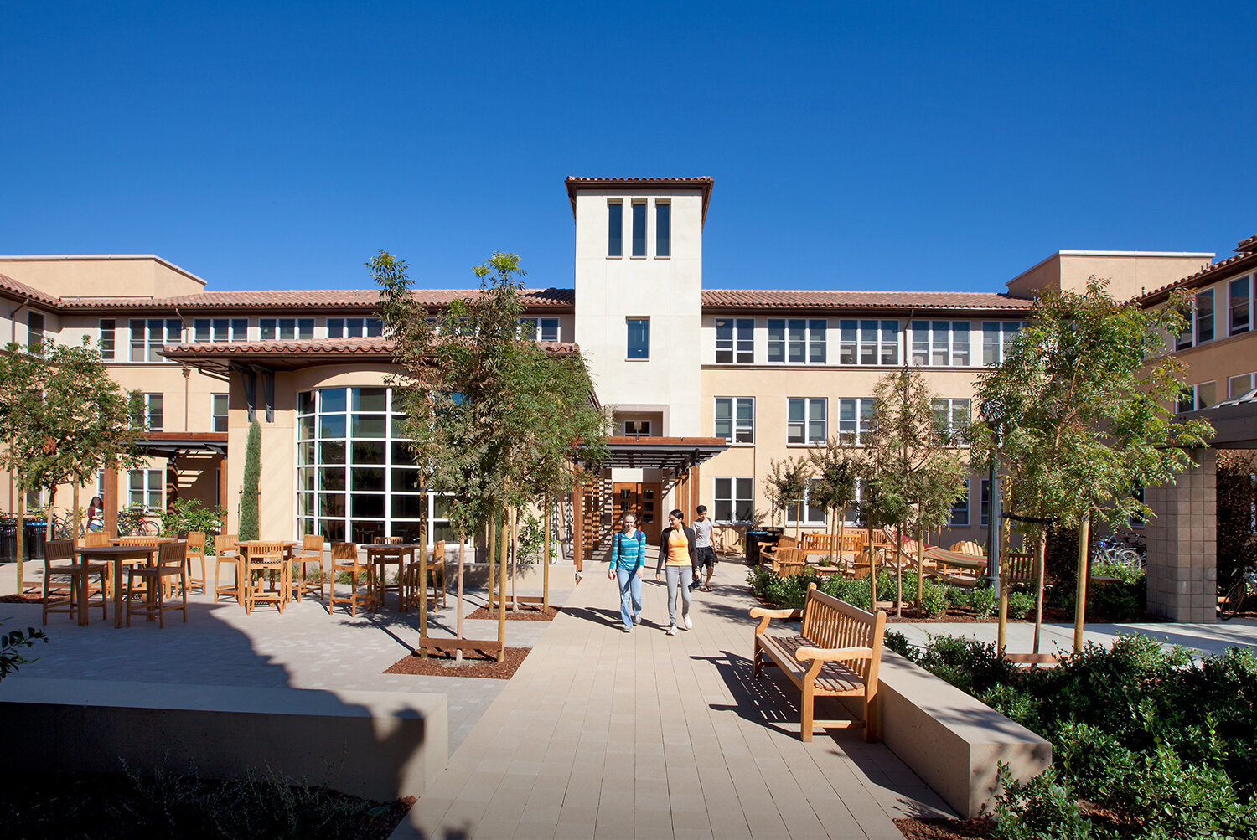

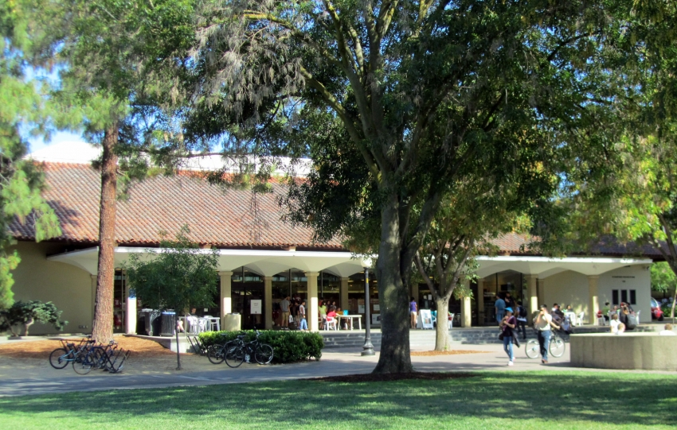
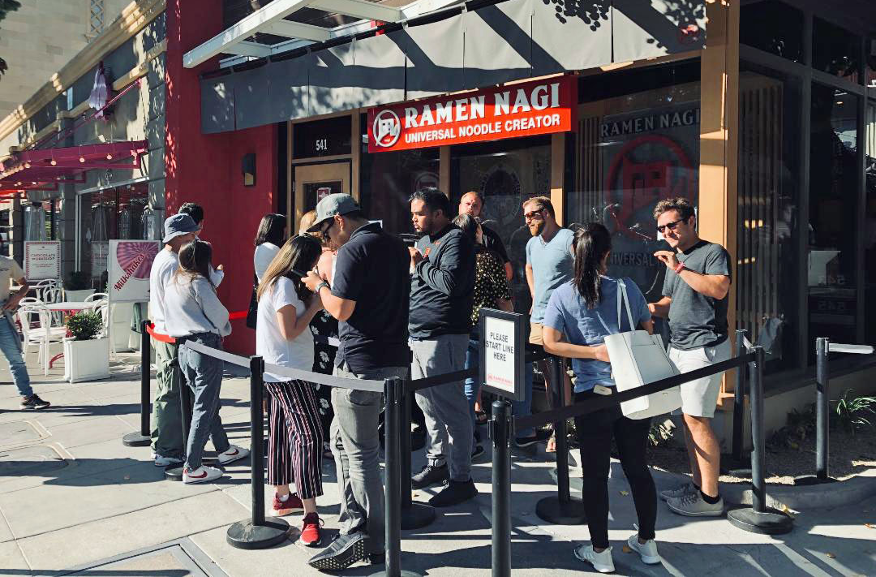
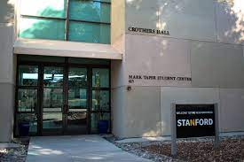
Finding Participants
White Plaza
Ng House
Stanford Bookstore
Ramen Nagi, Palo Alto
Stanford ResEd Office
Notes:
try to encounter people with diverse backgrounds
have an extreme user in mind and scheduled a meeting

Slide 5
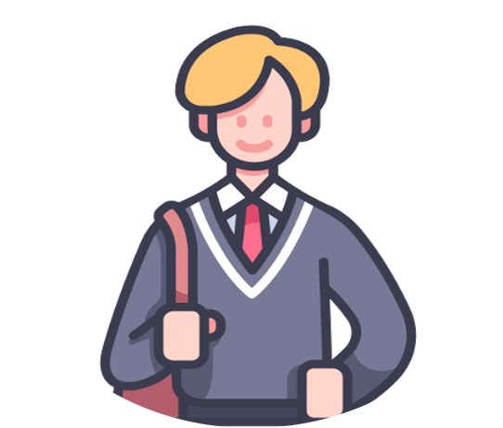


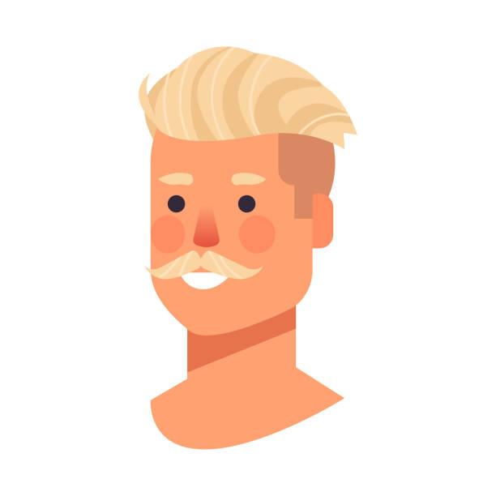
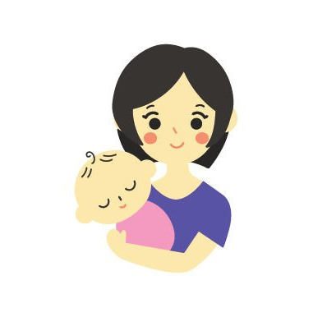
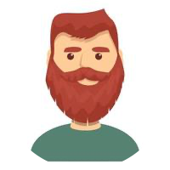

Julian
17-yr-old
high school student
Palo Alto
We Interviewed…
David
Zirui
Collin
DJ
52
commercials at a solar panel company
Palo Alto
32
chemical instrument company
Mountain View
35
college admissions consultant
32
residential director
@ Stanford
Abby
Julian
Non-User
Extreme User
Almost Never Use
Always Use
Notes:
A total of 6 interviews
We chose 4 to analyze in detail
Ranging from non-user (almost never consume media) to extreme user (consume media very frequently)

Slide 6
Some Questions We Asked
Do you normally consume media alone? With people? Which do you prefer and why?
How do you pick new shows to watch, new music to listen to?
What’s been your fondest media/entertainment-relatedmomery?
What type(s) of media do you consume the most? What’s your favorite show/music/podcast/book and why?
What motivates you to download a new app? To share content online?
Make a big impact with professional slides, charts, infographics and more.
What’s been your fondest memory regarding media/entertainment?
Why do you consume media? How does it make you feel? How do you fit it into your schedule?
Make a big impact with professional slides, charts, infographics and more.
Make a big impact with professional slides, charts, infographics and more.
How do you interact with media you’ve already finished consuming?
Make a big impact with professional slides, charts, infographics and more.
Notes:
Otter.ai to record and transcribe the interview

Slide 7
David
“
I am Social Media Anti-Social[...] I’m only on my phone reading Yahoo News, Google News, and CNN[...]
Ah, I've probably seen every crash and burn video ever made. In the first clip the kid on the board I can tell you how he's gonna cry.
52
Commercials at a solar panel company
Living in Palo Alto
”
Notes:
outdoor person (skateboarding); almost never use media entertainment apps;
only use phone to read news (less than 10 min a day) or watch skateboarding videos in the past

Slide 8
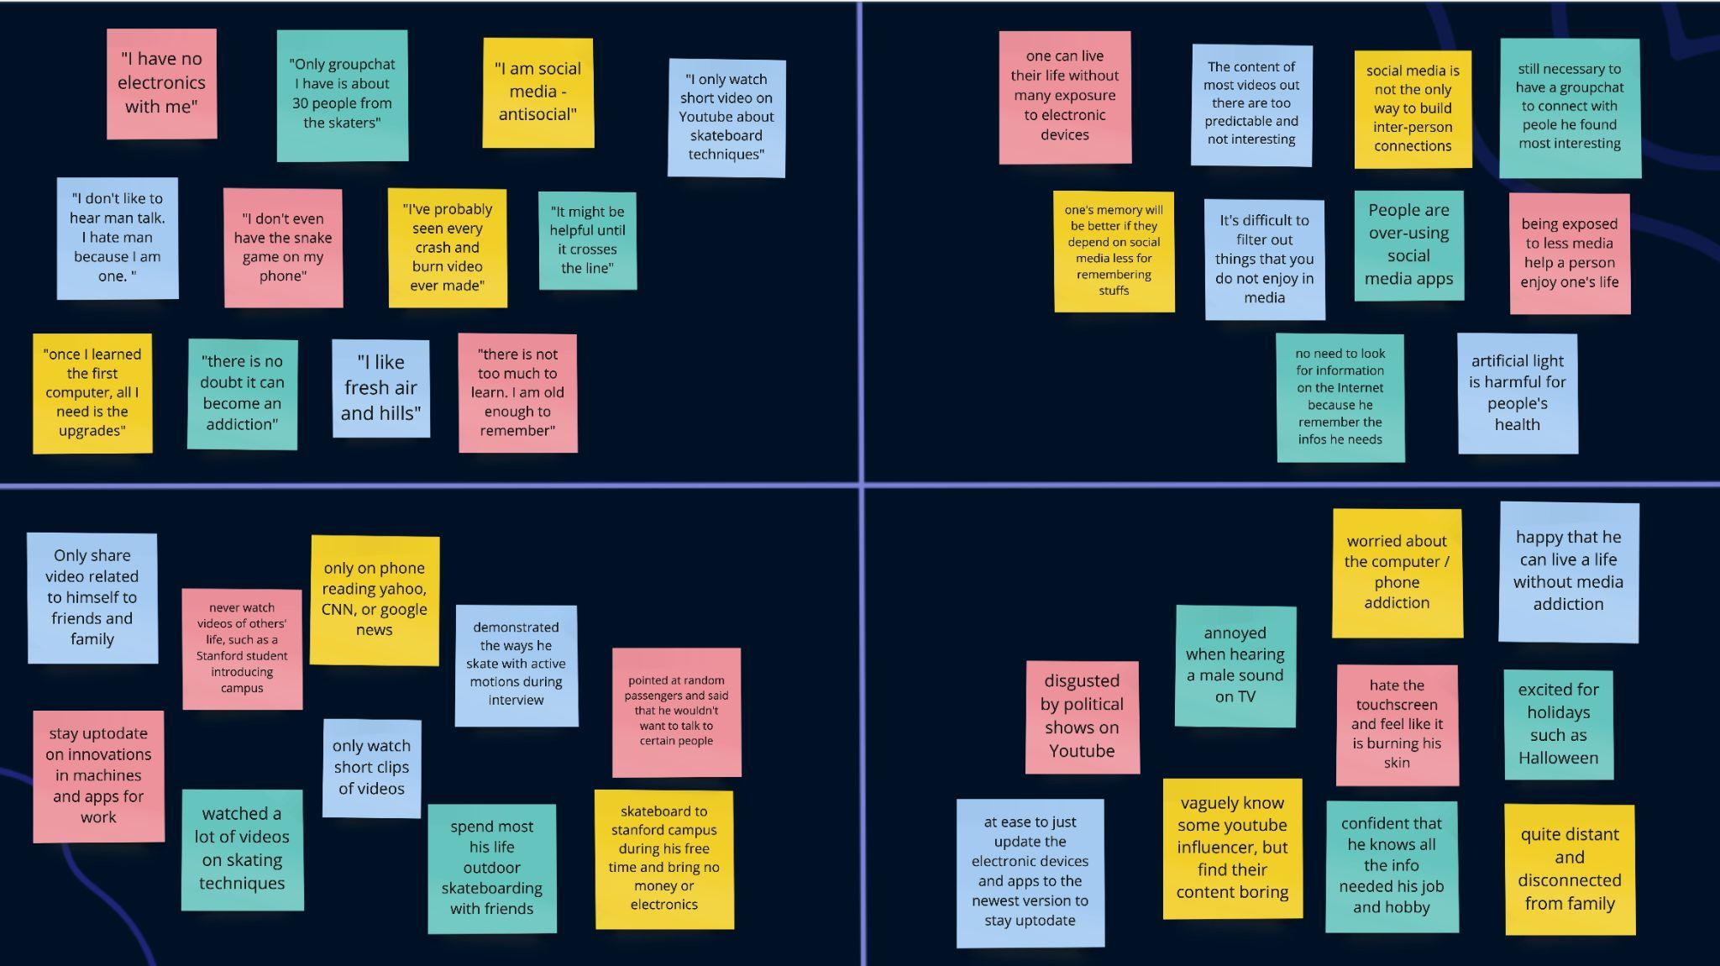
Say
Think
Do
Feel

Slide 9
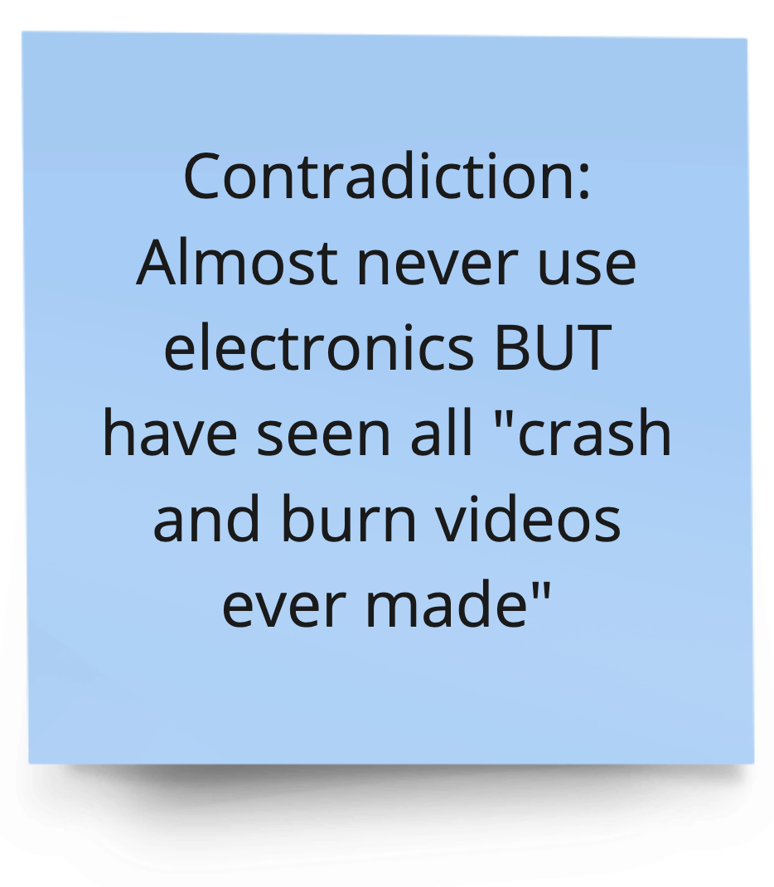
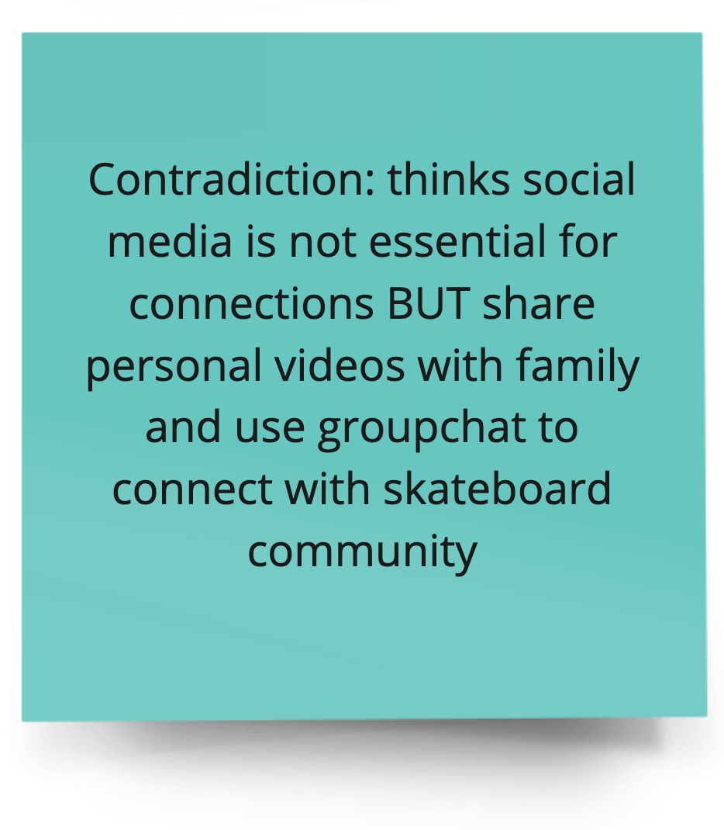
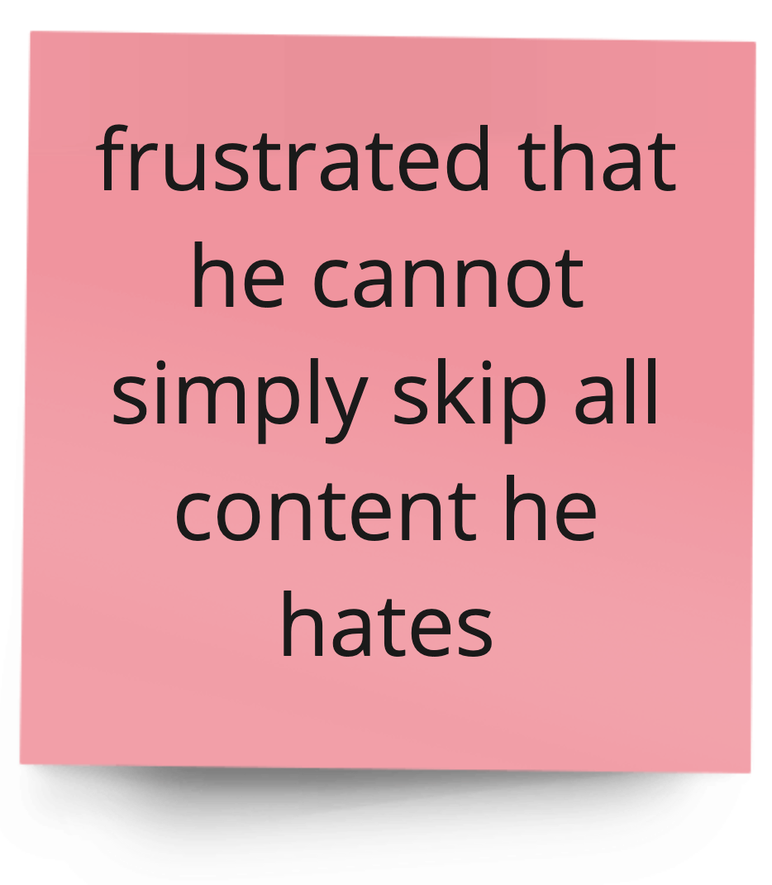
Say
Think
Do
Feel
Notes:
Strong likes and dislikes in content

Slide 10
Insights & Needs from David
Insights
Needs
Some people consume media only out of passion towards hobbies and use platforms to interact with family or core community.
People are often distracted by uninteresting content that they don’t wish to see.
People want to have direct and undistracted ways to access content and communities they are truly passionate about.

Slide 11
Zirui
“
I think it's important to know about Japan’s wastewater release. However, I don't really care what some actor or actress is wearing today.
”
32
Married, mother of a 1-yr-old daughter
chemical instrument company
Mountain View
Notes:
spend a lot of time on religious practices and family
only use phone to browse over news or cute videos when tired;
“secretly” subscribed an internet novel (read once a week for 10 min)

Slide 12
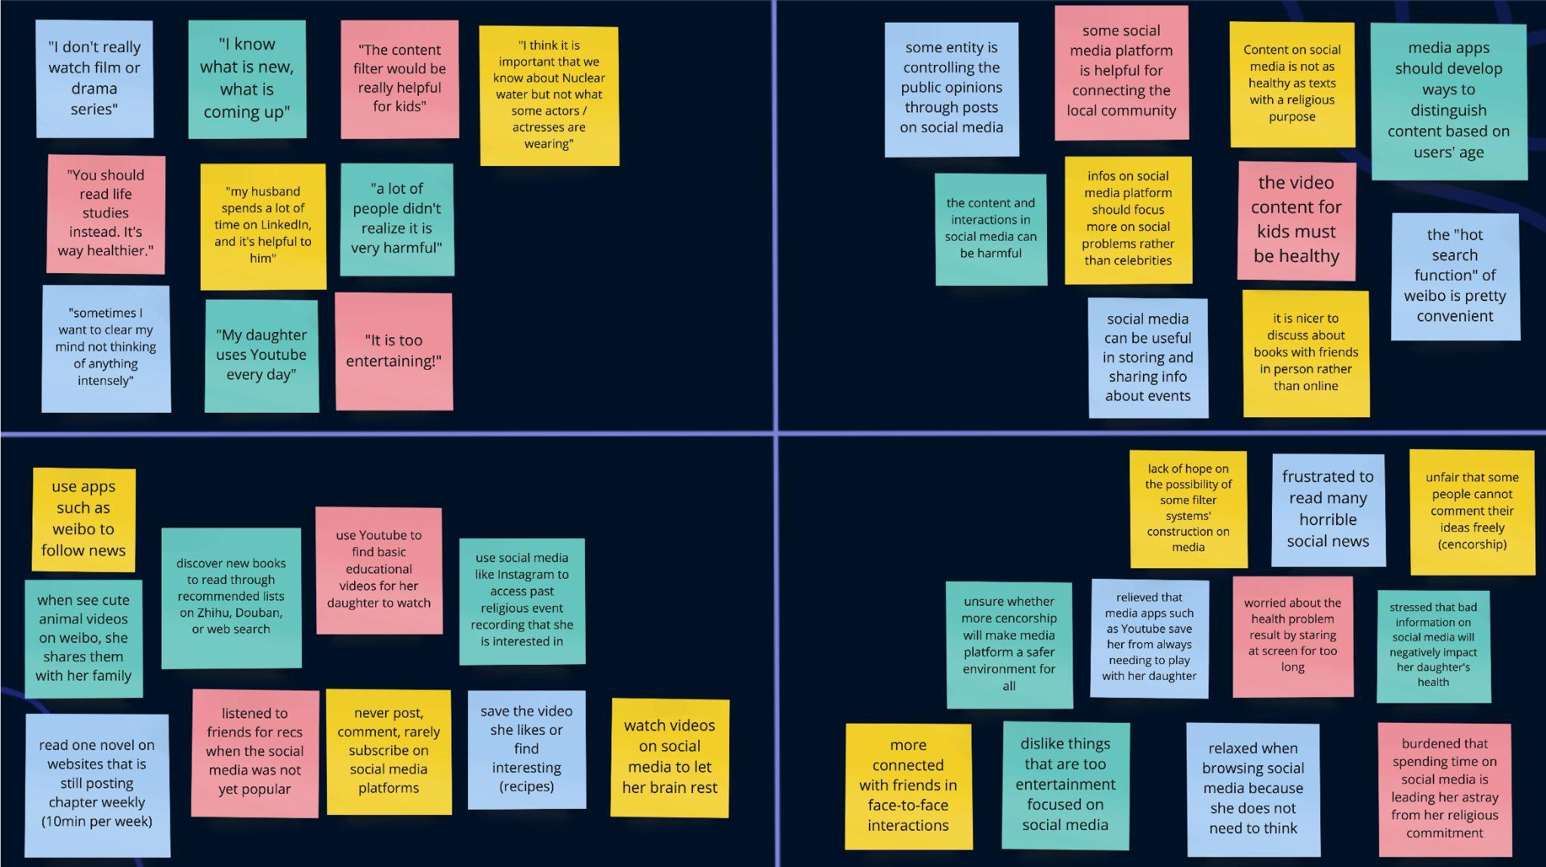
Person 1- main points, highlights, etc.
Say
Think
Do
Feel

Slide 13
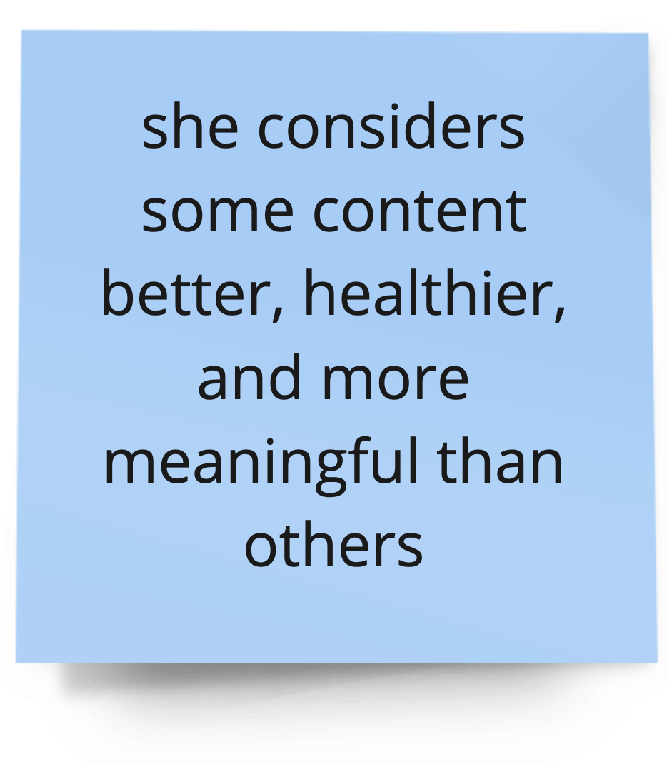
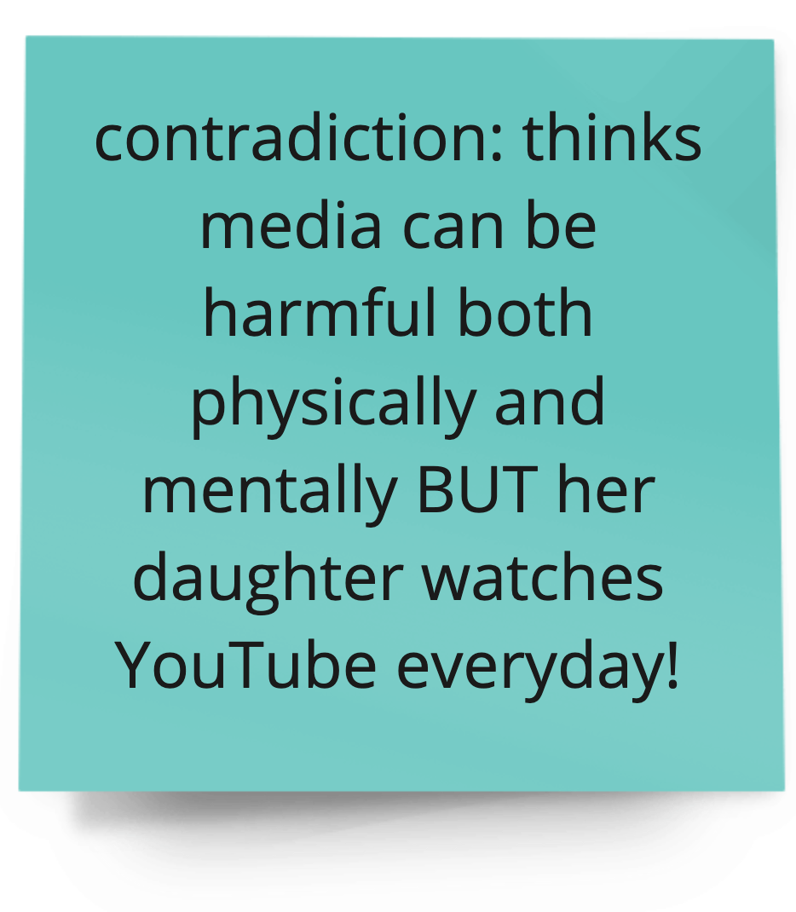
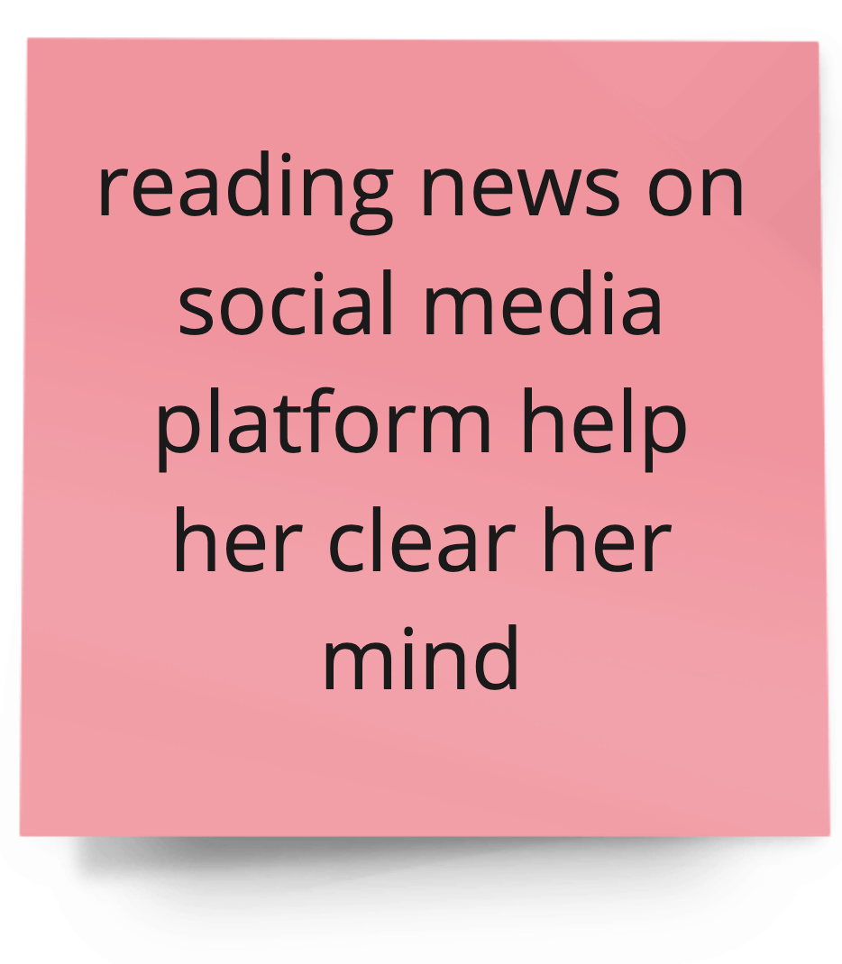
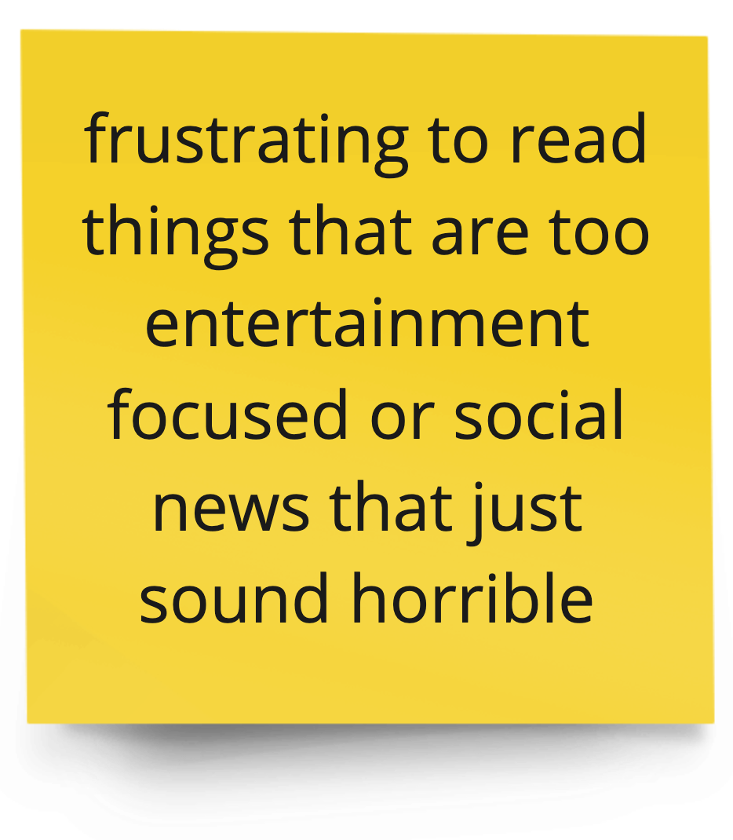
Person 1- main points, highlights, etc.
Say
Think
Do
Feel
Notes:
Contradiction: she makes sure that all content for her kid is healthy

Slide 14
Insights & Needs from Zirui
Insights
Needs
People think media is harmful but are still “pushed to” use it for practical purposes.
People want to absorb information from media in a healthy and relaxing way. They want to be able to select the types of content they want to see.
Notes:
Social media is a source of practical information, not entertainment for Zirui.
People use social media for various reasons, but prefer seeing content only in spaces or genres they enjoy.

Slide 15
Collin
“
It’s mostly just me and my wife. [...] I don’t really go to the movies anymore. I usually just rent it or do it on Netflix. [...] [For picking what to watch we] just turn on Netflix and see what pops up mostly
”
35
Married,
College Admissions Consultant
Notes:
"I don't really go to movies anymore. I usually just rent it or do it on Netflix."

Slide 16
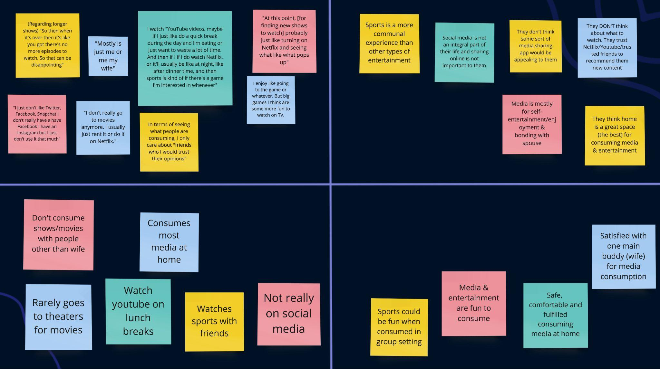
Person 1- main points, highlights, etc.
Say
Think
Do
Feel

Slide 17
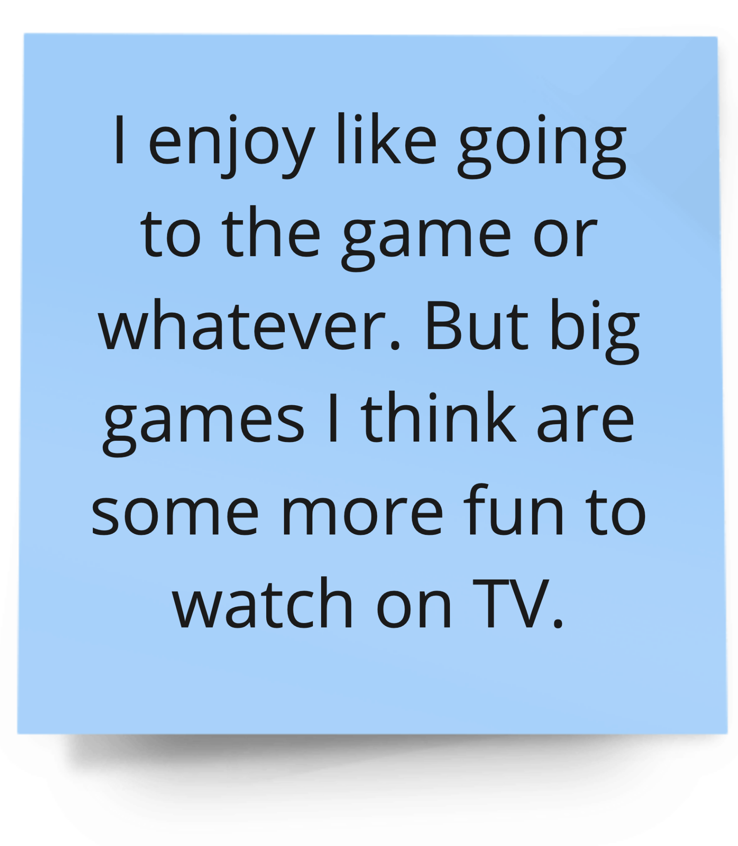
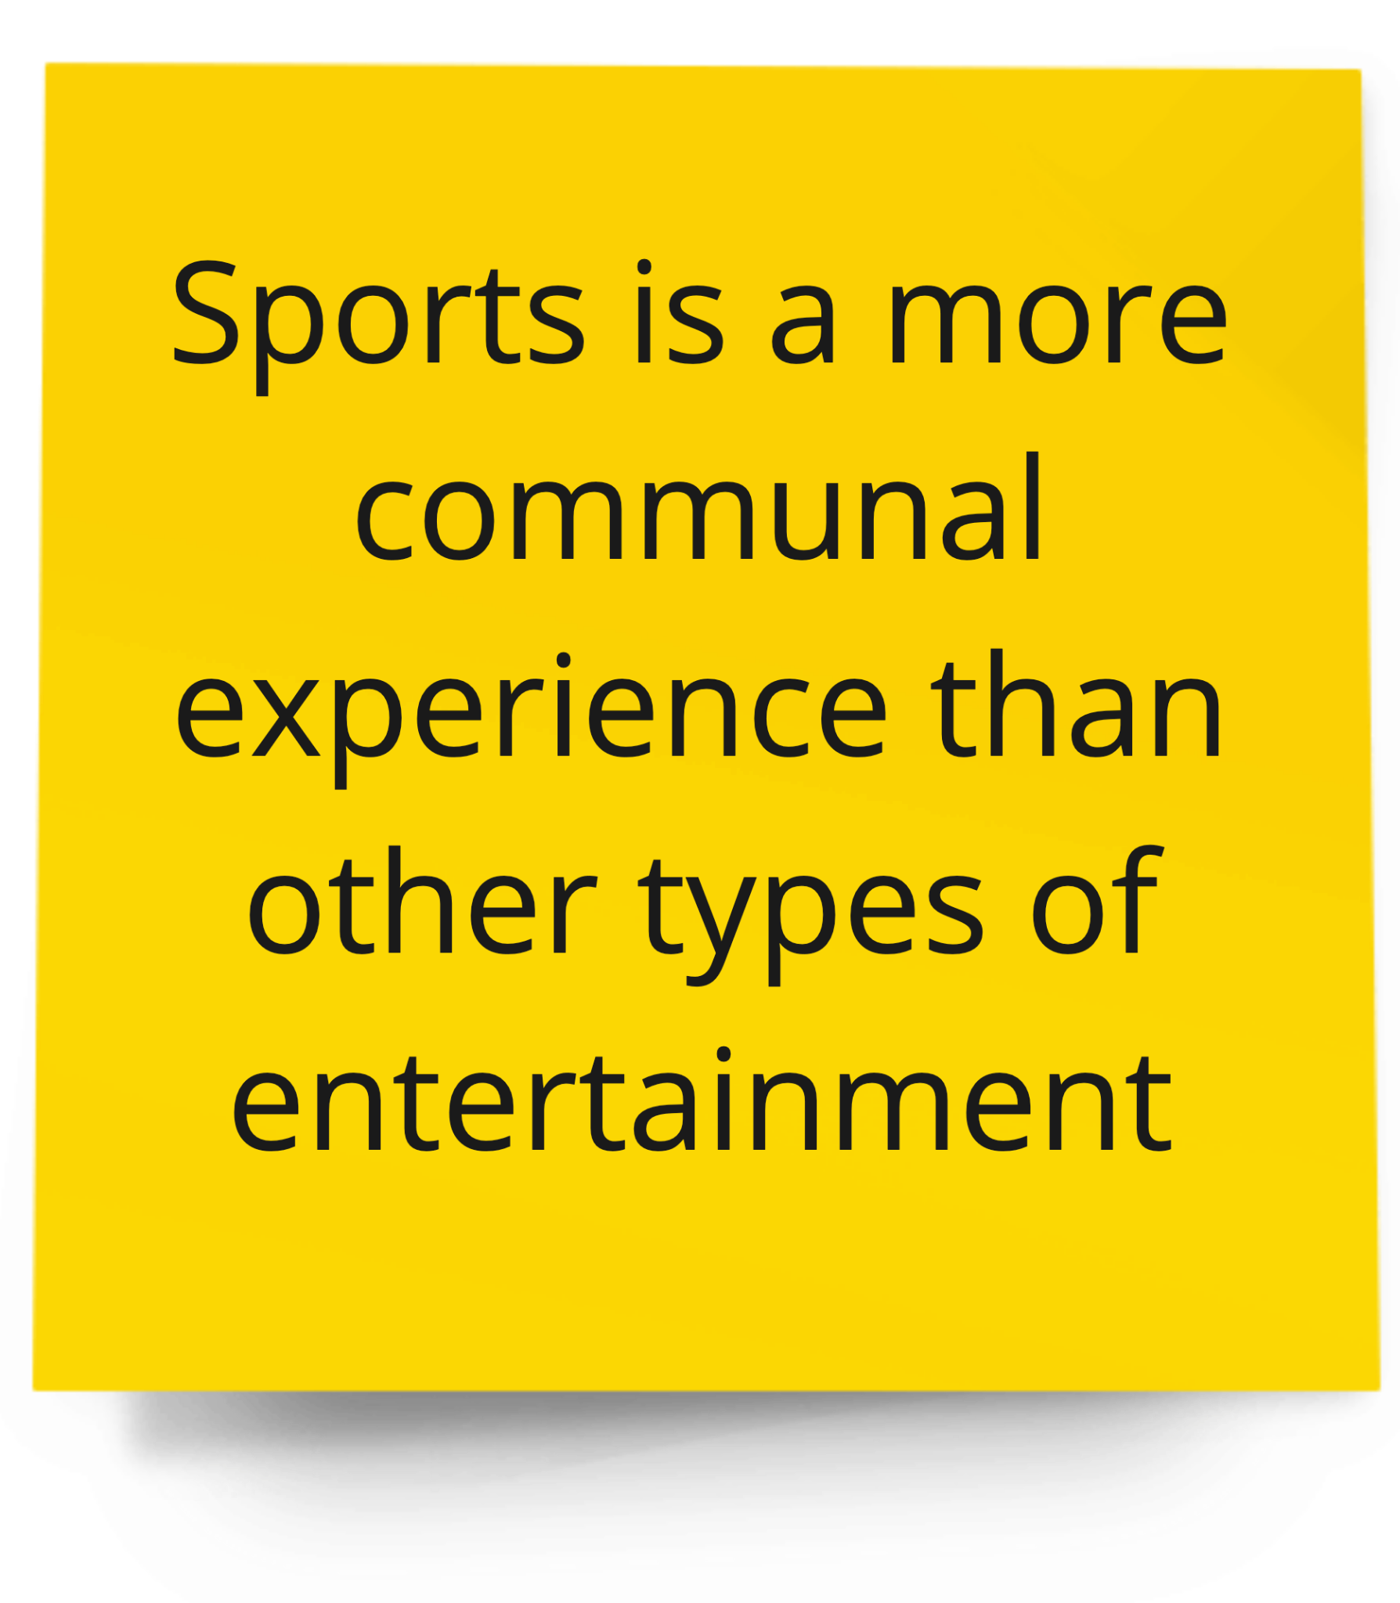
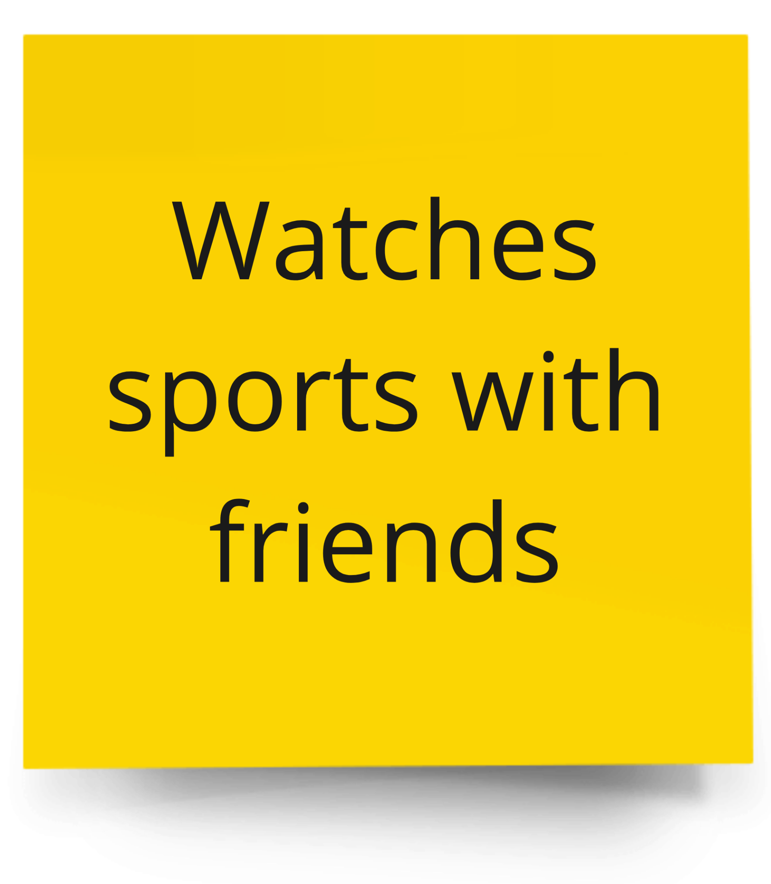
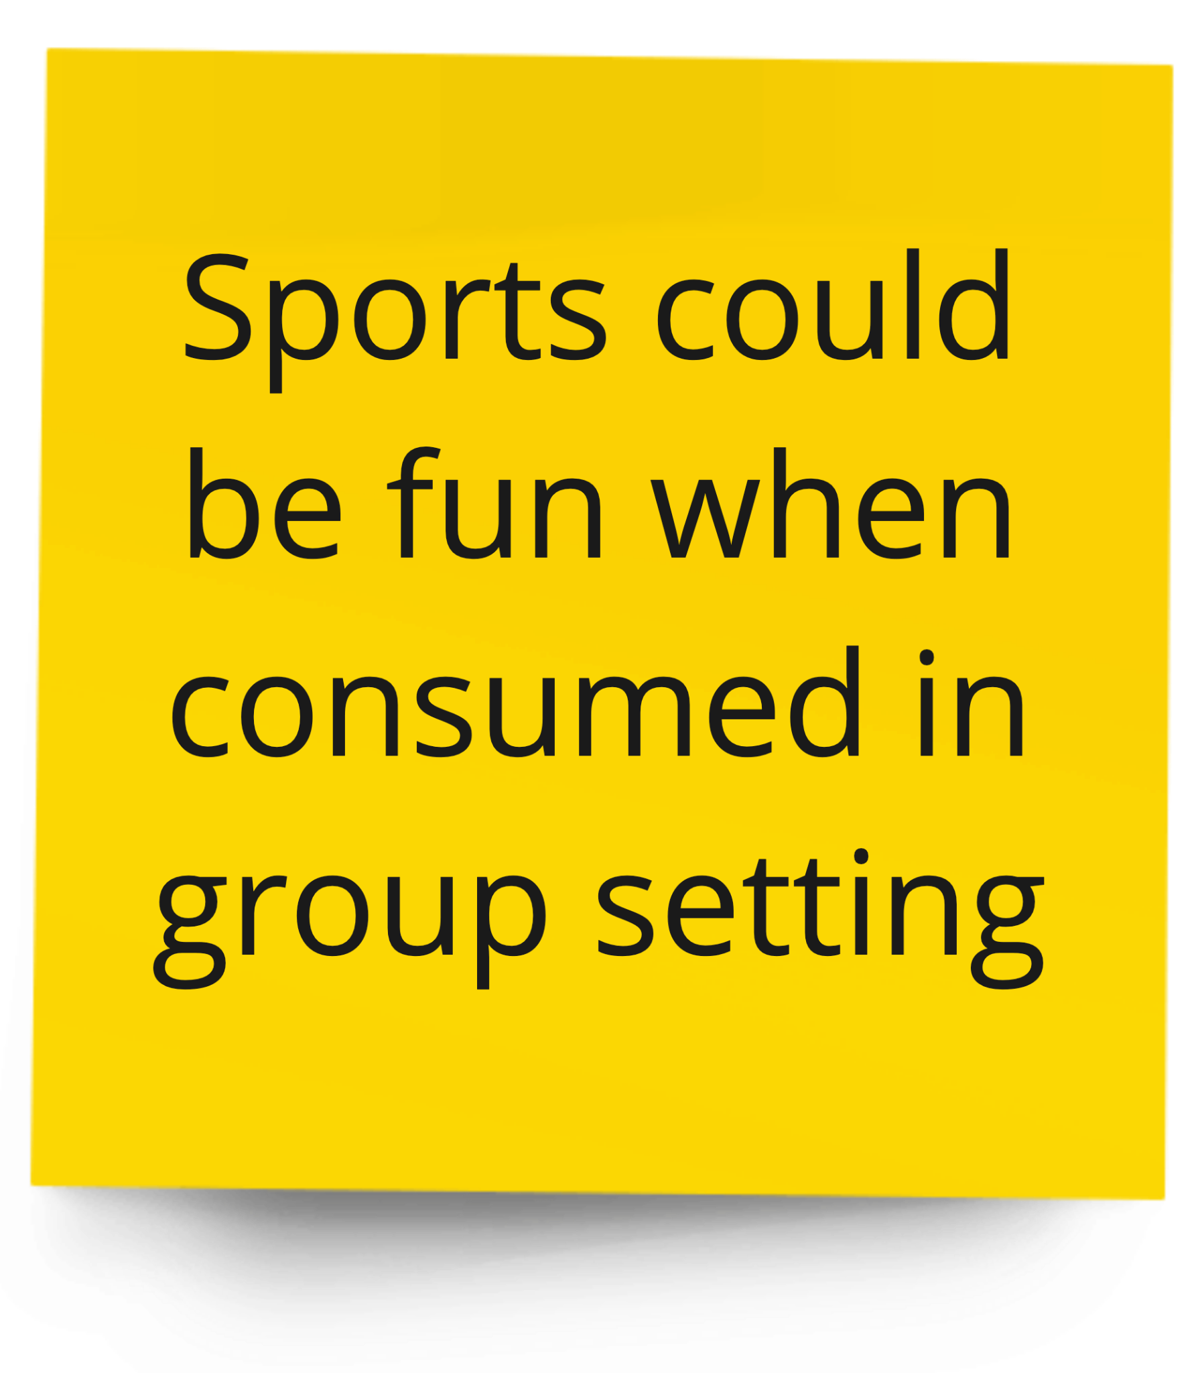
Person 1- main points, highlights, etc.
Say
Think
Do
Feel
Notes:
sports thread
Social Aspect of Media

Slide 18
Insights & Needs from Collin
Insights
Needs
People want a community or someone to share media experiences with in real time – the more the merrier
Consumption of media is mostly for self-enjoyment but more fun when consumed in a social context.

Slide 19
DJ,
“
I normally watch shows with my wife and kid. [...] As I’ve gotten older, I think the way I build relationships are a lot different, and more of my time that I would spend on building friendships are focused on family now.
”
32
Married w/ a 2-yr-old
Residential Director
@ Stanford
San Jose

Slide 20
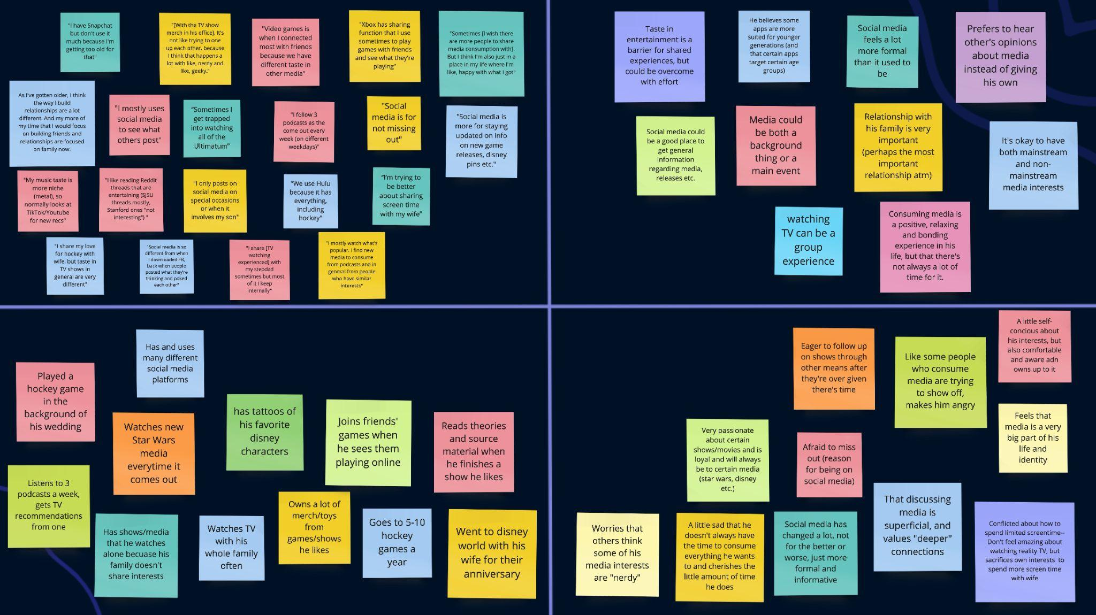
Person 1- main points, highlights, etc.
Say
Think
Do
Feel

Slide 21
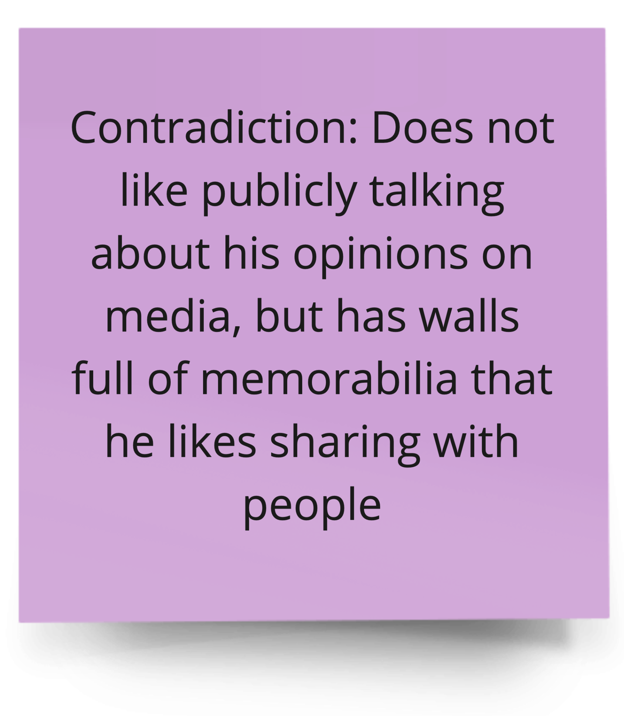
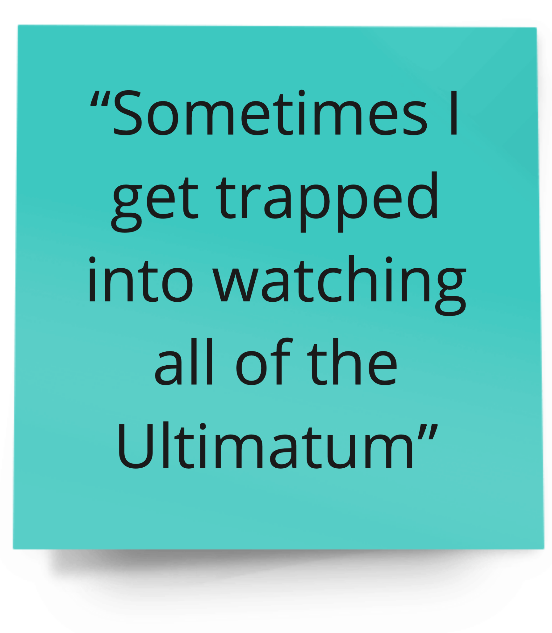
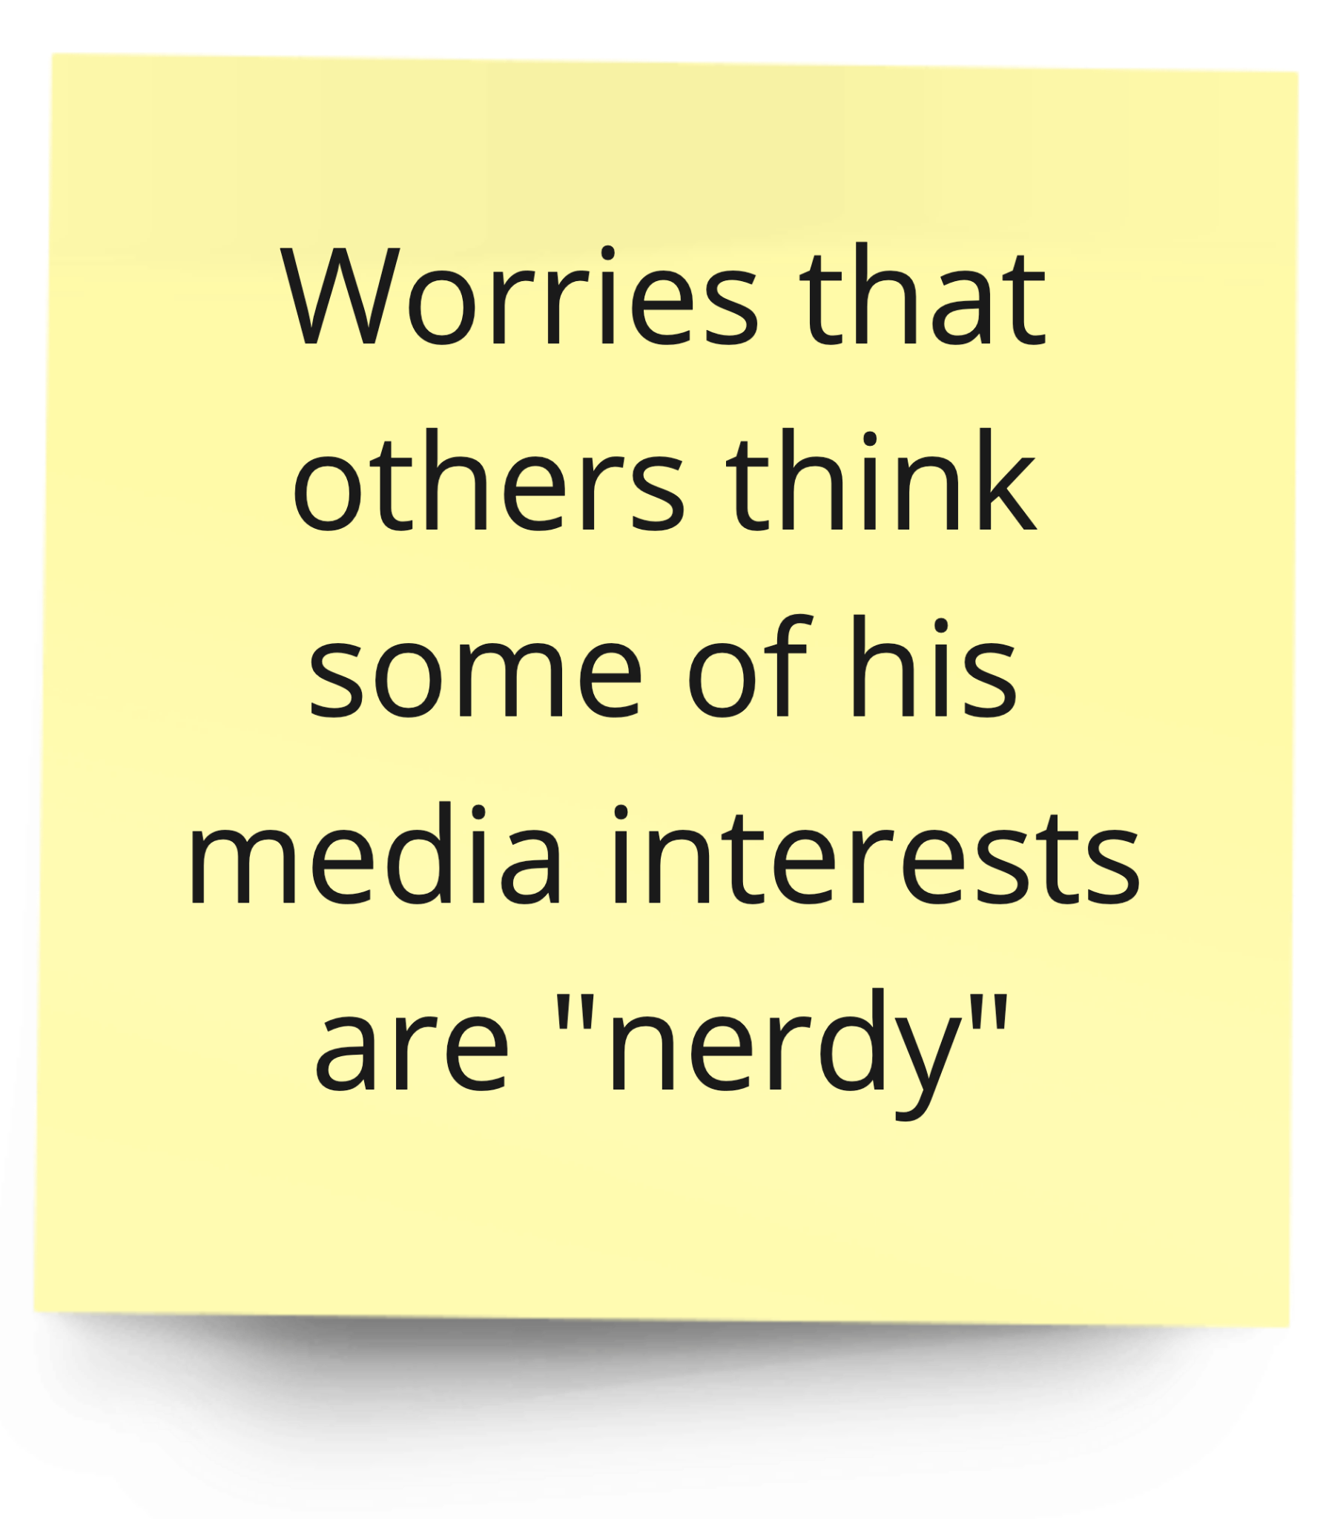
Person 1- main points, highlights, etc.
Say
Think
Do
Feel
Notes:
surprising

Slide 22
Insights & Needs from DJ
Insights
Needs
Having different taste in media is a barrier to shared consumption of content, but those with families may sacrifice their own preferences to prioritize shared screen time.
Balance of limited screen time between self and family.
Safe space to geek out about certain shows without judgement/competition.

Slide 23
Overall Insights & Needs
Insights
People sometimes only wish to see the things they want to see but there are way too many distractions.
Those with families have to balance between self and family screen time
Needs
Users want to be able to select and curate the types of content they interact with regularly.
People want to achieve enjoyment and connection and sense of community through using media entertainment platforms.

Slide 24
Key Learnings
Connection
Consumption
Curation
with others drives how people use and consume digital content
of content versus the creation of content depends heavily on the use case and the user
of the types of content that people consume is essential to their enjoyment

Slide 25
Next Steps
01
More Interviews
Find inspired challenges
03
Diversify the age group and gender group
Discover what challenges people are facing through POVs and HMWs
Experiment with approaches
Narrow down domain
04
02
Explore aspects of media and entertainment
Use design strategies to try out new solutions
Notes:
More interviews? -> Diversify the age group and gender group

Slide 26
Thank You!
Any Questions?

Slide 27
Credits
This presentation template was created by Slidenest, using resources from these sites:
Images
https://unsplash.com/es/fotos/VnfqkxCSCrU
https://unsplash.com/photos/tZc3vjPCk-Q
https://unsplash.com/photos/pl9DrjAMV6I
https://unsplash.com/es/fotos/TCeSrR11chw
https://unsplash.com/photos/wKOKidNT14w
https://unsplash.com/photos/OpgJPy3zjDE
https://unsplash.com/es/fotos/ZdUNNTZdHag
https://dribbble.com/shots/12047781-Digital-Agency-Hero
https://dribbble.com/shots/21782982-Softphone-App-wip-p2
Fonts
Playfair Display: https://fonts.google.com/specimen/Playfair+Display
Montserrat: https://fonts.google.com/specimen/Montserrat

